Slide 1
jQuery Jubilee
Lesson 5.2

Slide 2

This shouldn’t be you:
Notes:
shutterstock_1128769874

Slide 3
Important Reminders
This course covers a lot of material quickly, so remember:
Instructors and TAs are here to help.
Feel encouraged to schedule a one-on-one during office hours.
One-on-one sessions are a great way to identify weaknesses and outline a plan to get back on track.
Office hours are held before and after class.

Slide 4
Today’s Class

Slide 5
Objectives
Use jQuery DOM manipulation to create simple games.
Practice jQuery on Captain Planet: The Game and Fridge Game.
Gain an initial understanding of lexical scope in JavaScript.
Understand click events.

Slide 6
Captain Planet: The Game!

Slide 7
Captain Planet: The Game!
jQuery Jubilee
Notes:
10-CaptainPlanetGame

Slide 8
Group Activity: Pseudocode Captain Planet
Examine the code for the Captain Planet game.
Then, describe how this code works at a high level in English
jQuery Jubilee
Notes:
Suggested Time: 7 minutes
Solution on next slide

Slide 9
Pseudocoding Captain Planet
Create an initial HTML layout using Bootstrap.
Add a reference to jQuery.
Assign unique class names to key buttons and images.
Use jQuery to capture when the corresponding buttons are clicked, using the $() identifier with the class name inside.
Create code that changes the CSS of target classes in response to click events.
jQuery Jubilee

Slide 10
Activity: Create a Captain Planet Superpower
12 minutes
jQuery Jubilee

Slide 11
Activity: Create a Captain Planet Superpower
Suggested Time: 12 minutes
Review the jQuery API documentation (api.jquery.com). Then, add a button of your own that gives Captain Planet a new power.
Examples:
Click to…stretch Captain Planet.
Click to…trigger a maniacal laugh.
Click to…create clones of Captain Planet.
Click to…create a shield (hint: border).
Click to…create fire or water (hint: images).
jQuery Jubilee

Slide 12
jQuery Recap
jQuery Jubilee

Slide 13

jQuery in a Nutshell
01
Find some HTML.
02
Attach to an event.
03
Do something in response.
jQuery Jubilee

Slide 14
jQuery in a Nutshell
We use the jQuery $( ) identifier to capture HTML elements:
Then, we tie the element to a jQuery method of our choice to capture events:
Finally, we modify the selected element or add or remove elements from the DOM:
$(“.classname”) | $(“div”)
$(“#idname”) | $(“p”)
.on(“click”) | .ready()
.animate() | .append() | .remove()
jQuery Jubilee

Slide 15
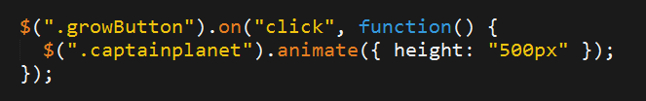

jQuery: A Common Example
01
02
Click the Grow button.
Make Captain Planet grow.
Superpowers: Change Sizes!
Normal
Grow
Shrink
jQuery Jubilee
Notes:
shutterstock_391065901

Slide 16
Use Documentation When Needed:
api.jquery.com
jQuery Jubilee

Slide 17
Group Challenge: Fridge Game
35 minutes
jQuery Jubilee

Slide 18


Group Challenge: Fridge Game
Suggested Time: 35 minutes
Working in groups of three, complete the code for the fridge game such that:
JavaScript dynamically generates buttons for each of the letters on the screen.
Clicking any of the buttons causes the same letter to be displayed on the screen.
Clicking the Clear button erases all of the letters from the fridge.
Note: This is a challenging activity. You may want one person in the group to type the code while the other two watch to catch bugs and research code snippets when necessary.
jQuery Jubilee

Slide 19
Crystal Collector
jQuery Jubilee

Slide 20
Lexical Scope
jQuery Jubilee

Slide 21
This next section is heavy on theory.
jQuery Jubilee

Slide 22
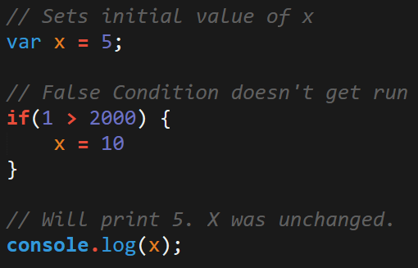
JavaScript Scope
In Javascript, curly brackets { } indicate blocks of code.
In order for the code inside the curly brackets to be executed, it must meet the condition or be called (example: functions).
These blocks of code can affect variables that were declared outside the curly brackets—so be careful!
jQuery Jubilee

Slide 23
Scope = Boxes in Boxes
Scope impacts which variables can be accessed by which function.

Slide 24
Scope = Boxes in Boxes
function global()
function inner()
function eveninner()
function innest()

Slide 25
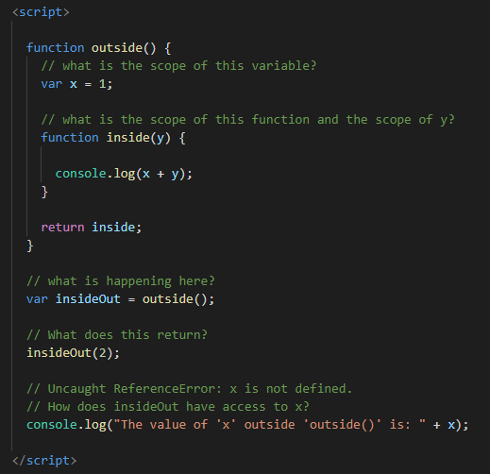
JavaScript Scope Example
Here, inside is clearly able to access the variables of its parent function, outside.
How does insideOut have access to x?

Slide 26
Activity: Lexical Scope 1
10 minutes

Slide 27
Activity: Lexical Scope 1
Suggested Time: 10 minutes
Review the file sent to you and explain the following to the person sitting next to you:
What do the terms parent function and child function mean?
Why can child functions access parent variables, but not vice versa?
Be prepared to share your answers!

Slide 28
Activity: Lexical Scope 2
7 minutes

Slide 29

Activity: Lexical Scope 2
Suggested Time: 7 minutes
Take a few moments to dissect the code just sent to you.
Try to predict what will be printed in each of the examples.
Be prepared to share!
Note: Pay attention to the unusual use of the keyword this.

Slide 30
Lexical Scope 2

Slide 31
Activity: Lexical Scope 3
7 minutes

Slide 32
Activity: Lexical Scope 3
Suggested Time: 7 minutes
Take a few moments to dissect the code just sent to you.
Try to predict what will be printed in each of the examples.
Be prepared to share!
Note: Pay attention to the unusual use of the keyword this.

Slide 33

Yep, I don't understand.
Notes:
shutterstock_678350425

Slide 34
If you’d like to learn more, here’s a helpful article:
What You Should Already Know about JavaScript Scope
spin.atomicobject.com

Slide 35
Challenge:
Color Corrector: Build a Brain Teaser
20 minutes plus additional 20 minutes at home

Slide 36
Color Corrector: Build a Brain Teaser
Choose the color of the word shown from the list below:
teal
brown magenta blue teal coral black

Slide 37
Challenge: Color Corrector: Build a Brain Teaser
Suggested Time: 20 minutes
Using the files sent to you as a starting point, add the missing code so that the Color Corrector game works correctly.
To win, choose the word that matches the color of the text at the top of the column.
Example:
brown
teal coral black brown magenta blue
brown
teal coral black brown magenta blue

Slide 38
Questions?

